Slide 1
Angular Compilar in Action

Slide 2
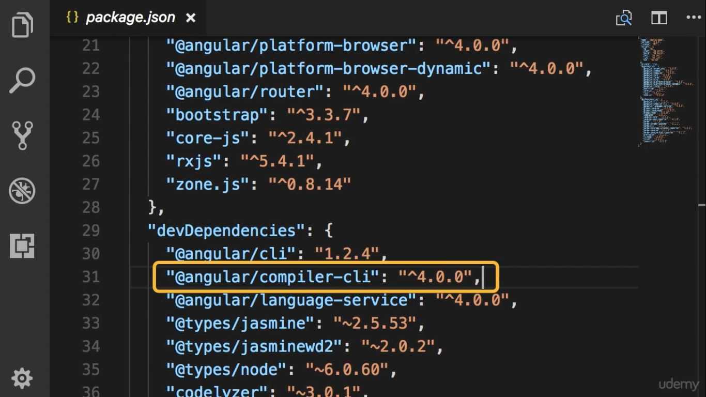
Vendor bundle ကိုလုပ္ေပးတဲ့သူ

Slide 3
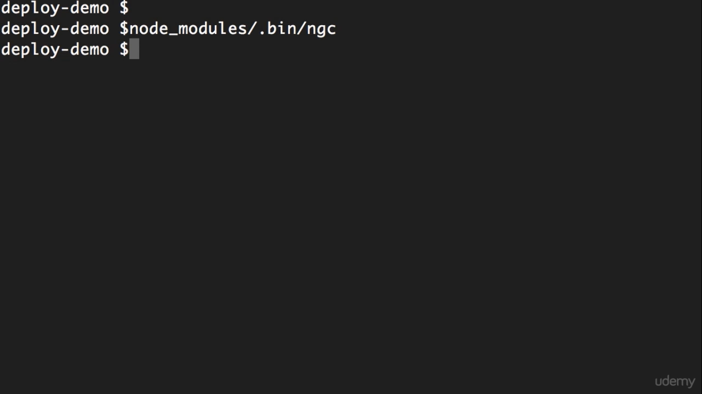
Binary files တည္႐ွိတဲ့ေနရာ

Slide 4
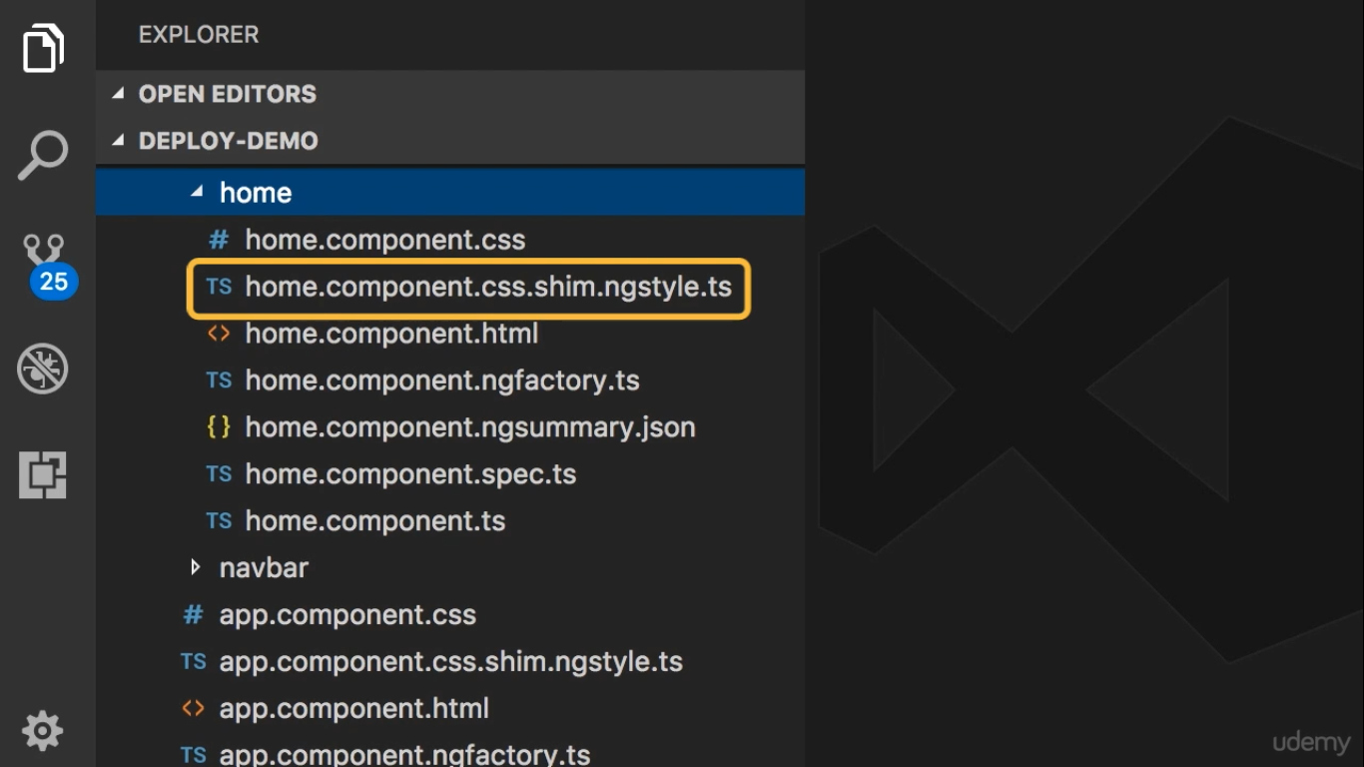

Slide 5
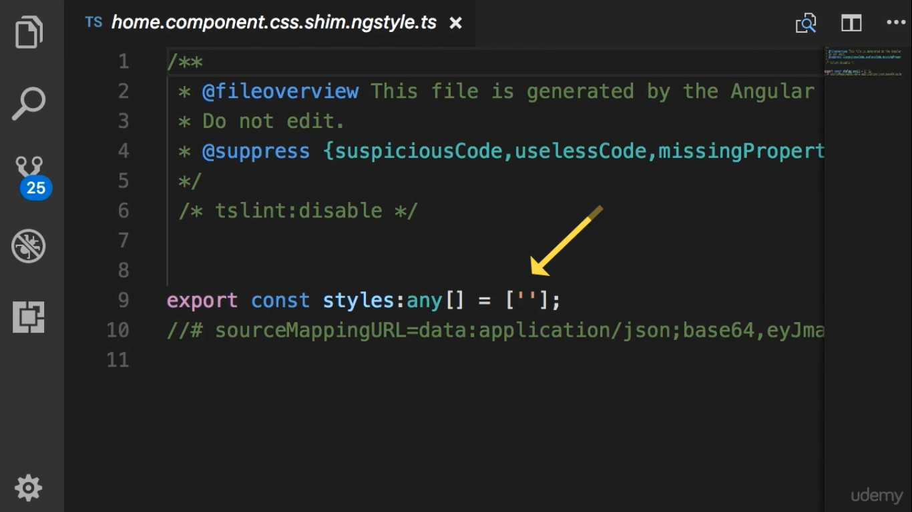
home component မွာ css code မ႐ွိတဲ့အခ်ိန္

Slide 6
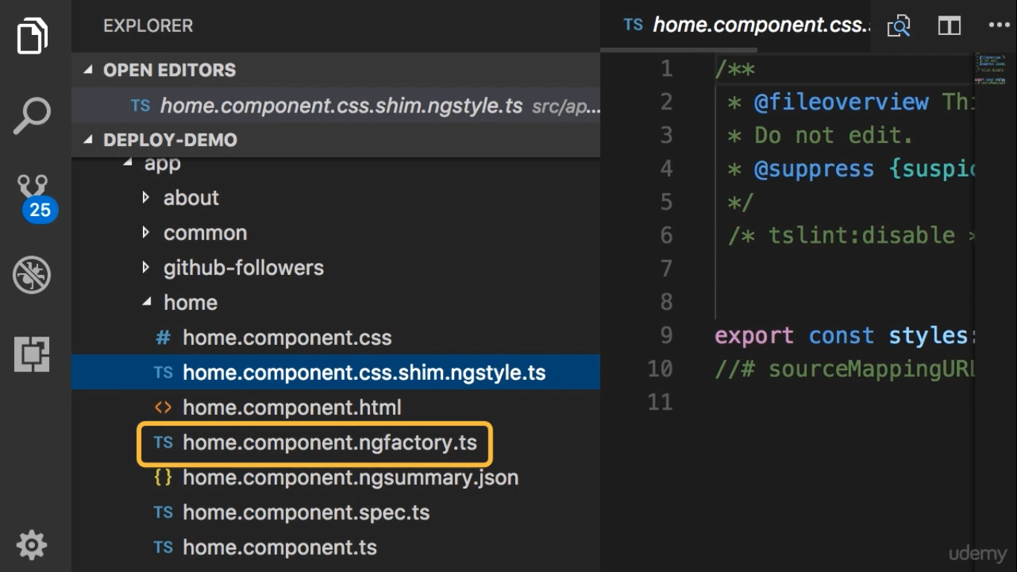
Angular application မွာပါတဲ့ component ေတြဆို
Ngfactory file ထုတ္ေပးတယ္

Slide 7
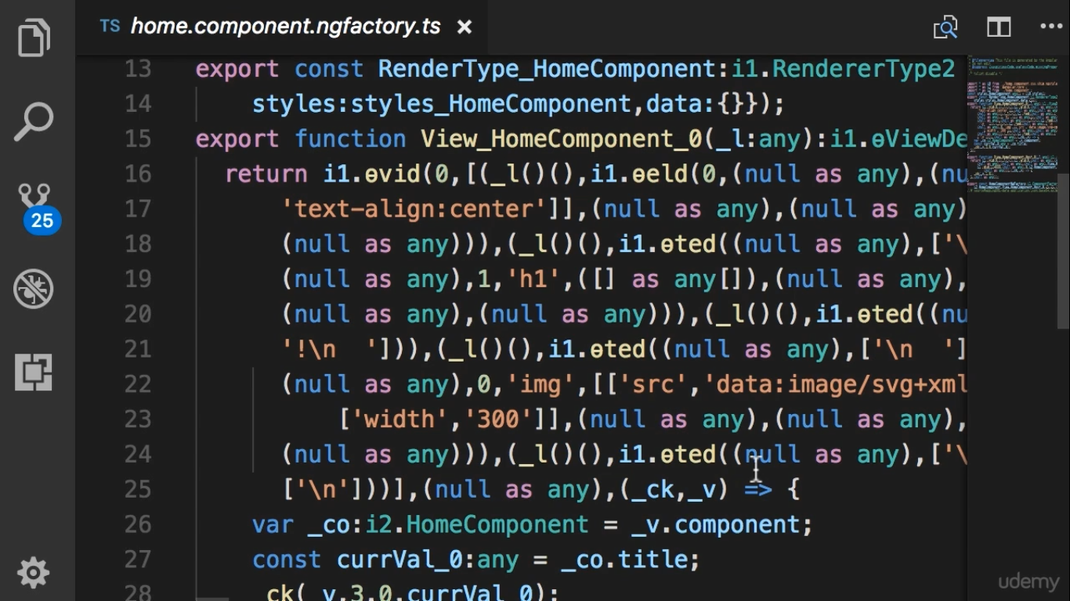
This is the combination of
our component and its
template

Slide 8
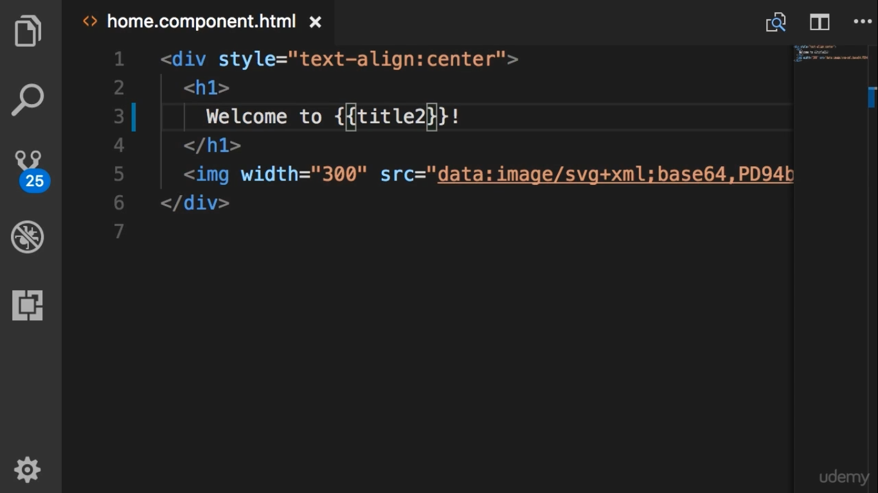
Change title to title2 and then compile again

Slide 9
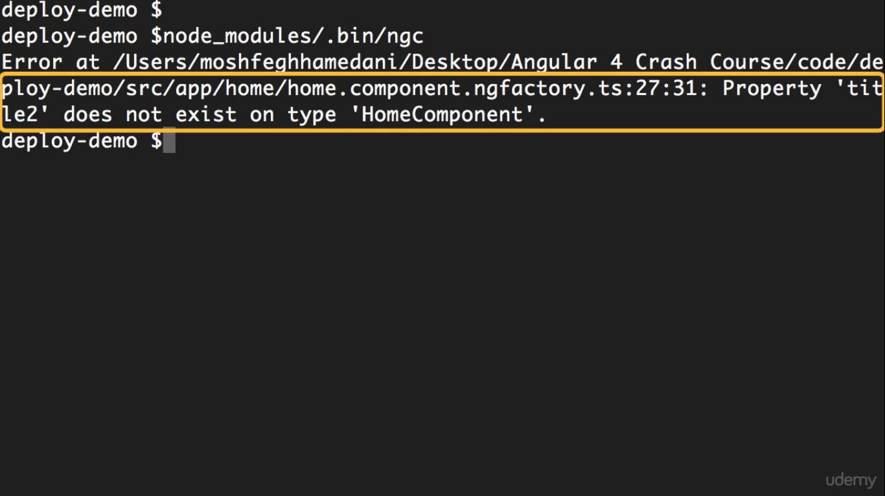
Here we get compilation error.

Slide 10
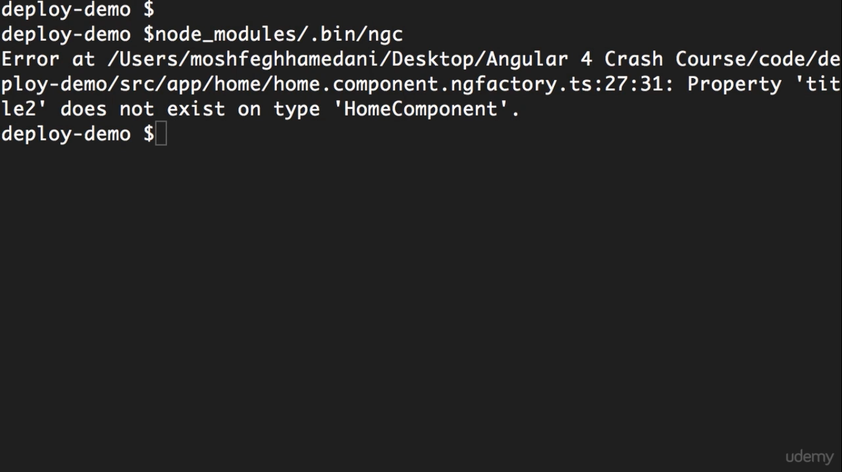
Angular CLI internally runs Angular Compiler

